Slide 1
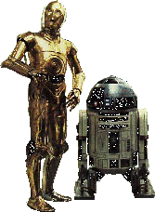
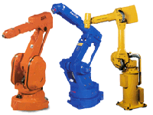
Introduction to Robotics
A common view : Robots as Humanoids
We will be studying Industrial manipulator type Robots.

Slide 2
Agenda
Introduction to Robotics
Classification of Robots
Robot accessories
Robot coordinates
Work volumes and Reference Frames
Robot Programming
Robot Applications in Lean Mfg.

Slide 3
ROBOT
Defined by Robotics Industry Association (RIA) as
  a re-programmable, multifunctional manipulator designed to move material, parts, tools or specialized devices through variable programmed motion for a variety of tasks
possess certain anthropomorphic characteristics
  mechanical arm
  sensors to respond to input
  Intelligence to make decisions

Slide 4
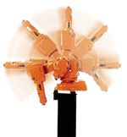
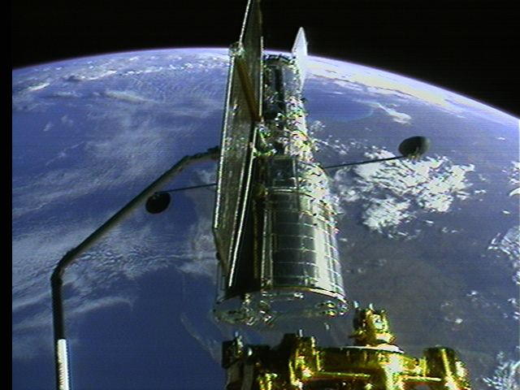
Robot Accessories
A Robot is a system, consists of the following elements, which are integrated to form a whole:
Manipulator / Rover : This is the main body of the Robot and consists of links, joints and structural elements of the Robot.
End Effector : This is the part that generally handles objects, makes connection to other machines, or performs the required tasks.
It can vary in size and complexity from a endeffector on the space shuttle to a small gripper

Slide 5
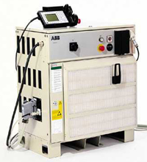
Accessories
Acutators : Actuators are the muscles of the manipulators. Common types of actuators are servomotors, stepper motors, pneumatic cylinders etc.
Sensors : Sensors are used to collect information about the internal state of the robot or to communicate with the outside environment. Robots are often equipped with external sensory devices such as a vision system, touch and tactile sensors etc which help to communicate with the environment
Controller : The controller receives data from the computer, controls the motions of the actuator and coordinates these motions with the sensory feedback information.

Slide 6
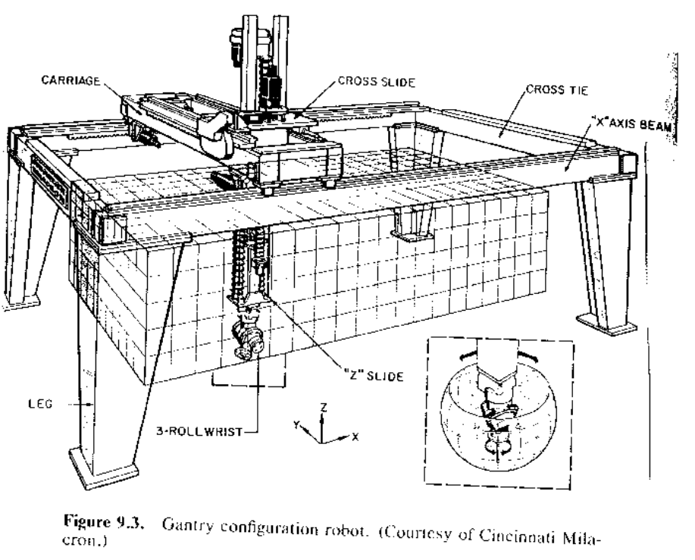
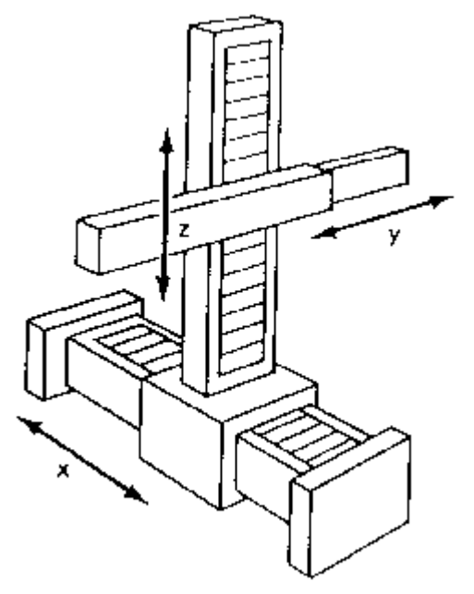
Robot Configurations
Some of the commonly used configurations in Robotics are
Cartesian/Rectangular Gantry(3P) : These Robots are made of 3 Linear joints that orient the end effector, which are usually followed by additional revolute joints.

Slide 7
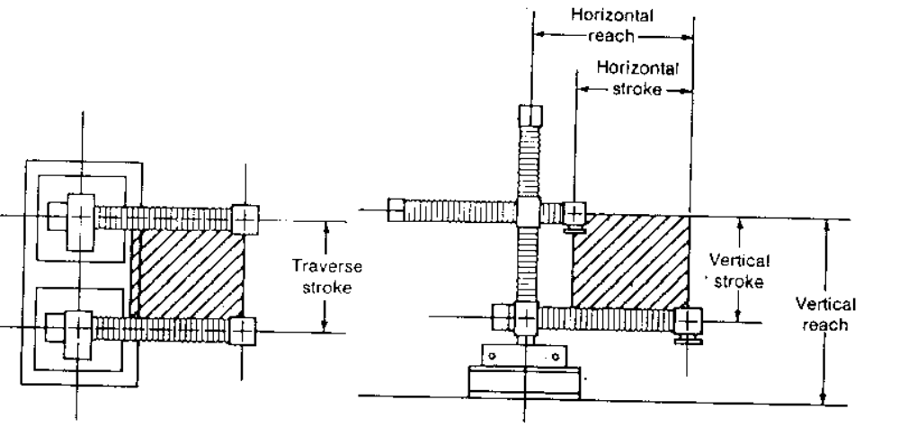
Cartesian Robot - Work Envelope

Slide 8
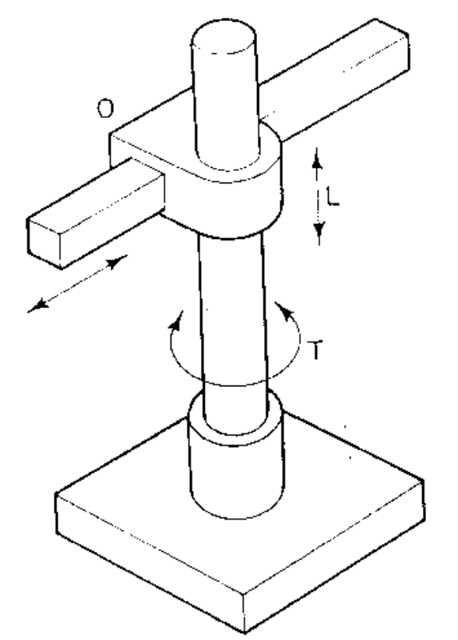
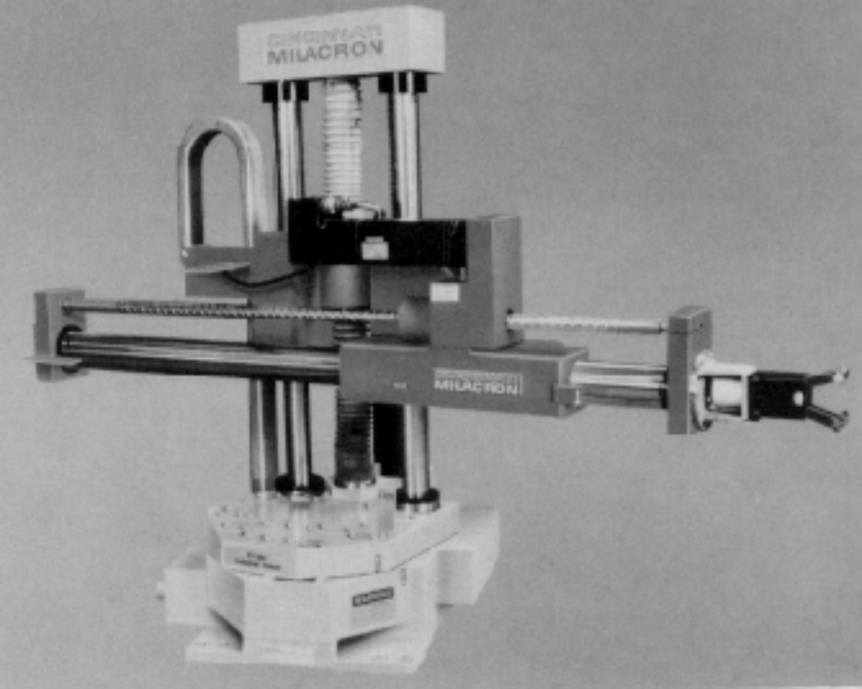
Robot Configurations (cont’d)
Cylindrical (R2P): Cylindrical coordinate Robots have 2 prismatic joints and one revolute joint.

Slide 9
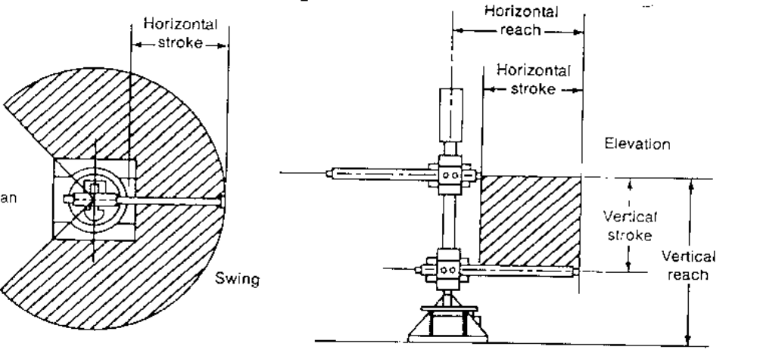
Cylindrical Robot - Work Envelope

Slide 10
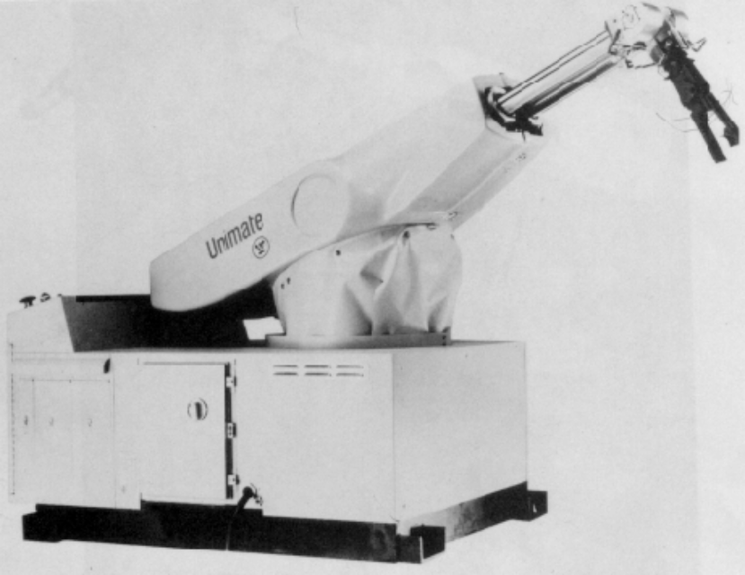
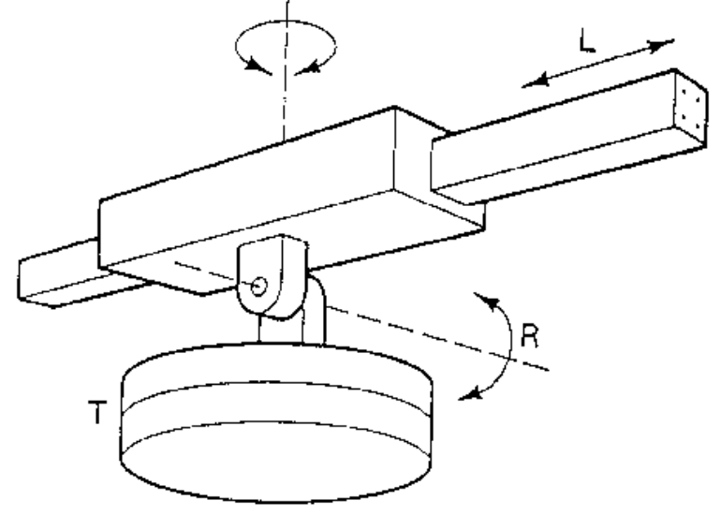
Robot Configurations (cont’d)
Spherical joint (2RP): They follow a spherical coordinate system, which has one

Slide 11
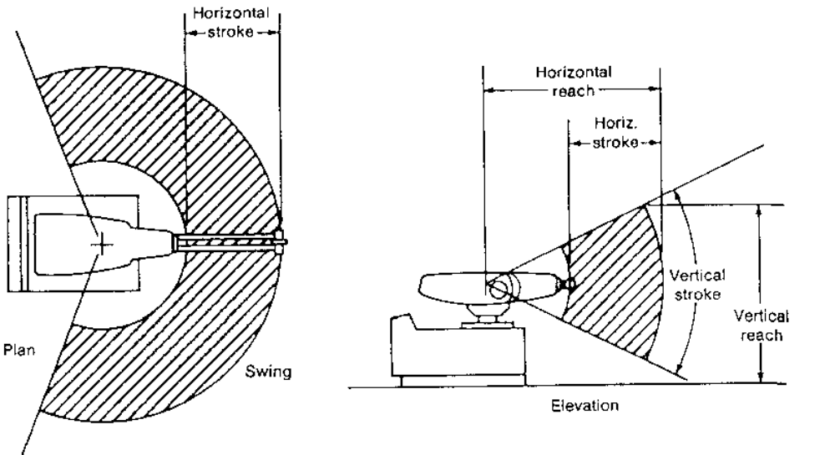
Spherical Robot - Work Envelope

Slide 12
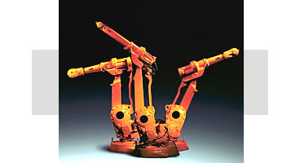
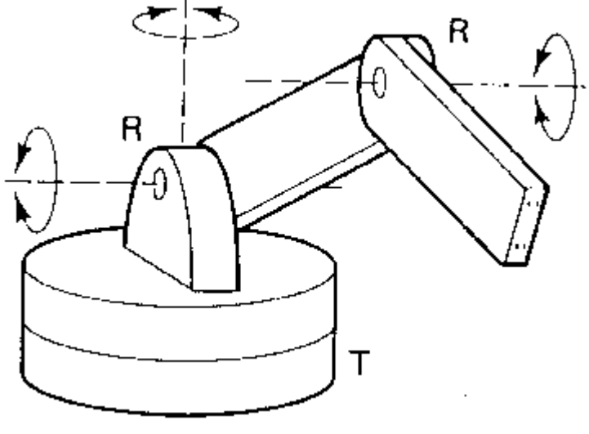
Robot Configurations (cont’d)
Articulated/anthropomorphic(3R) :An articulated robot’s joints are all revolute, similar to a human’s arm.

Slide 13
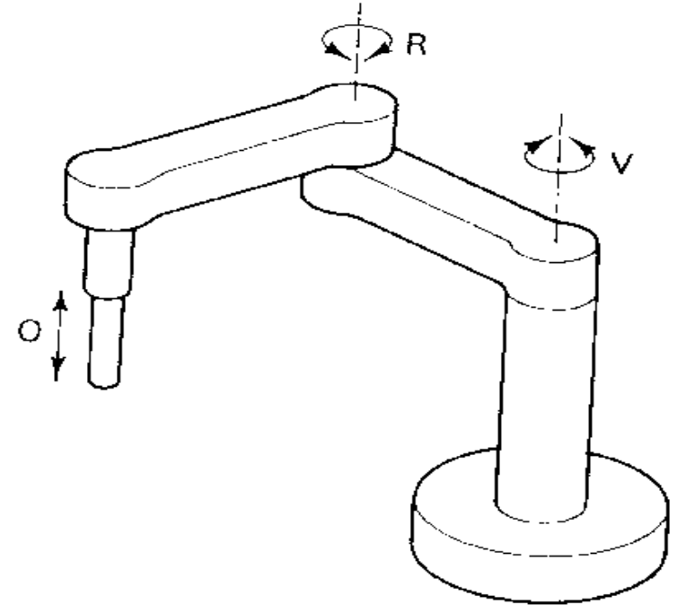
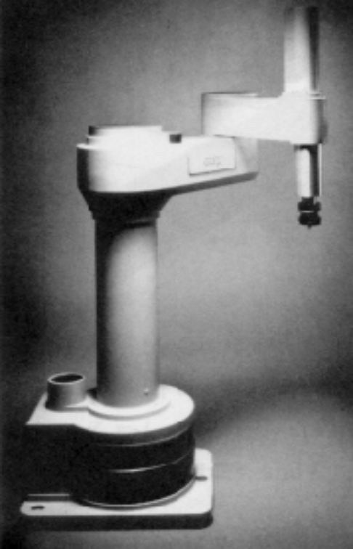
Robot Configurations (cont’d)
Selective Compliance Assembly Robot Arm (SCARA) (2R1P): They have two revolute joints that are parallel and allow the Robot to move in a horizontal plane, plus an additional prismatic joint that moves vertically

Slide 14
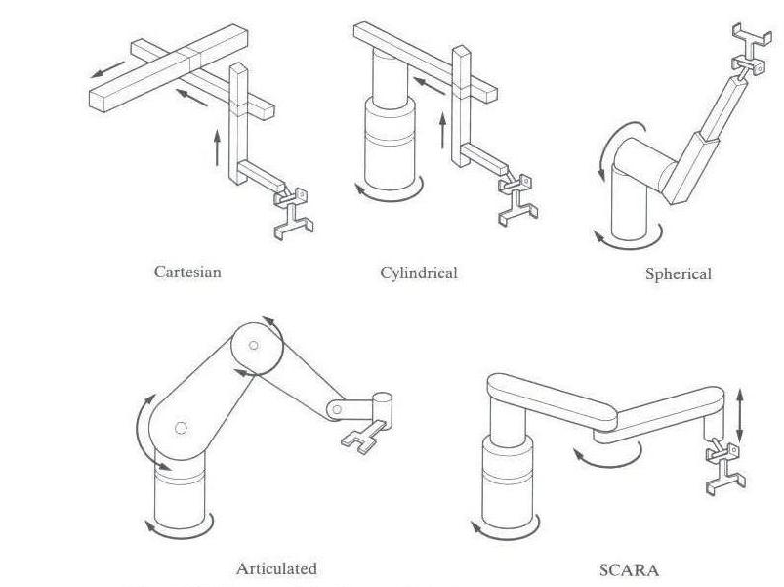
Robot Configurations

Slide 15
Reference Frames
World Reference Frame which is a universal coordinate frame, as defined by the x-y-z axes. In this case the joints of the robot move simultaneously so as to create motions along the three major axes.
Joint Reference Frame which is used to specify movements of each individual joint of the Robot. In this case each joint may be accessed individually and thus only one joint moves at a time.
Tool Reference Frame which specifies the movements of the Robots hand relative to the frame attached to the hand. The x’,y’and z’ axes attached to the hand define the motions of the hand relative to this local frame. All joints of the Robot move simultaneously to create coordinated motions about the Tool frame.

Slide 16
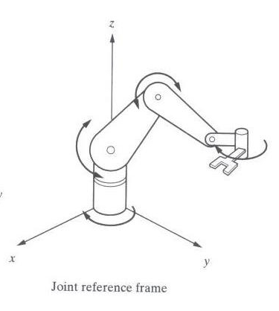
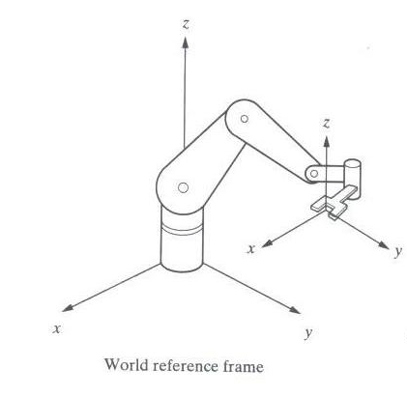
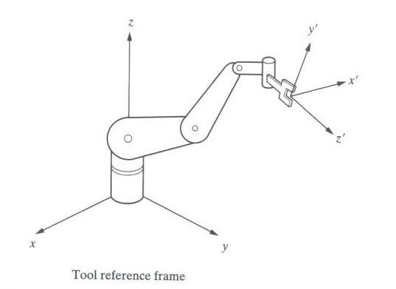
Robot Reference Frames

Slide 17
Work Envelope concept
Depending on the configuration and size of the links and wrist joints, robots can reach a collection of points called a Workspace.
Alternately Workspace may be found empirically, by moving each joint through its range of motions and combining all space it can reach and subtracting what space it cannot reach

Slide 18
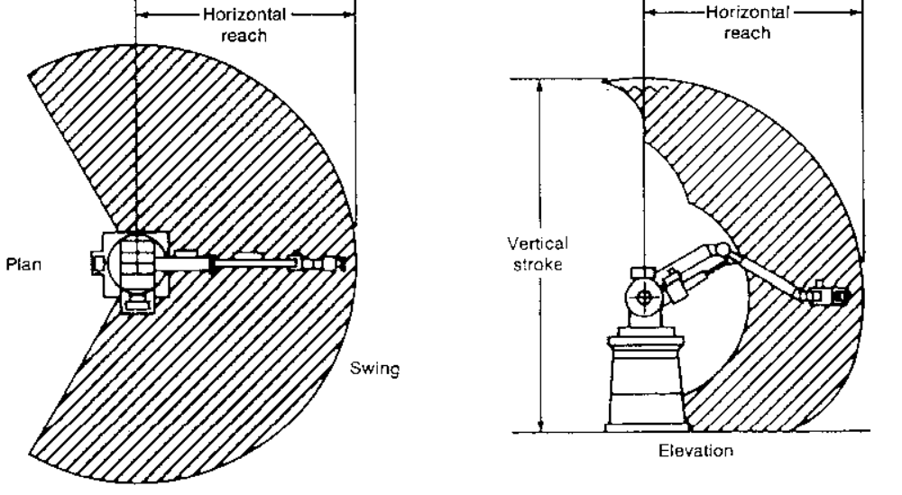
Pure Spherical Jointed Arm - Work envelope

Slide 19
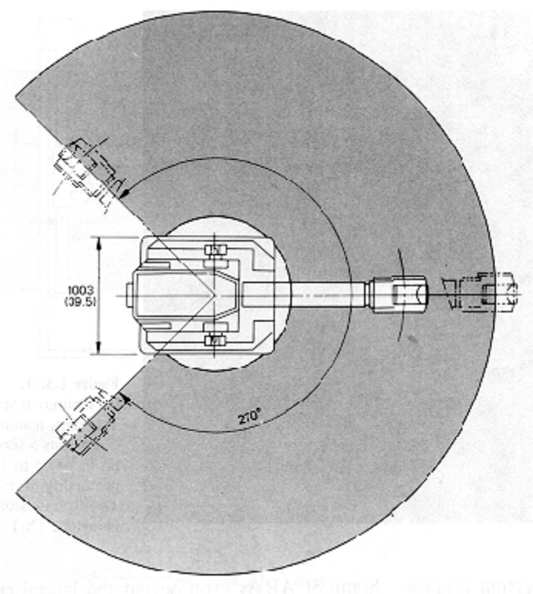
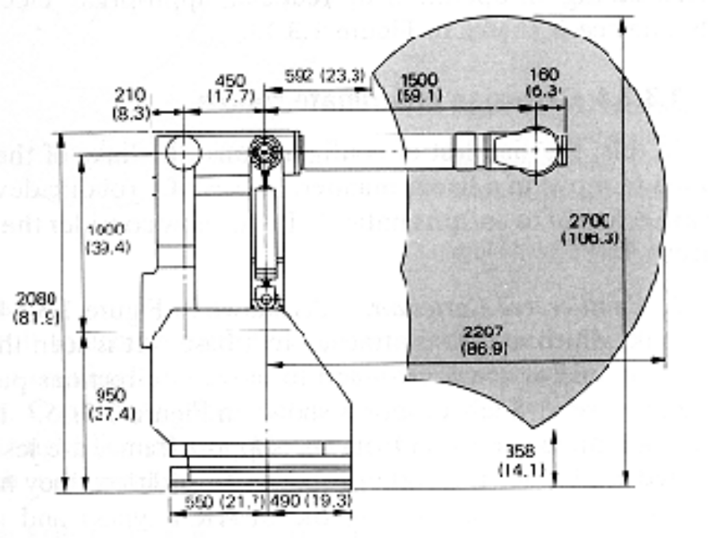
2) Parallelogram Jointed

Slide 20

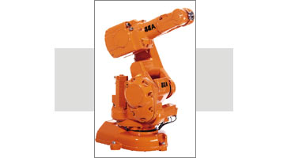
Exercise
Readiness Assessment Test A.K.A. RAT
AS A INDIVIDUAL, prepare a detailed response for the following Readiness Assessment test
What type of Robot Configuration does the ABB 140 Robot have?
Can you find out its Work
Space?

Slide 21
WRIST
typically has 3 degrees of freedom
  Roll involves rotating the wrist about the arm axis
  Pitch up-down rotation of the wrist
  Yaw left-right rotation of the wrist
End effector is mounted on the wrist

Slide 22
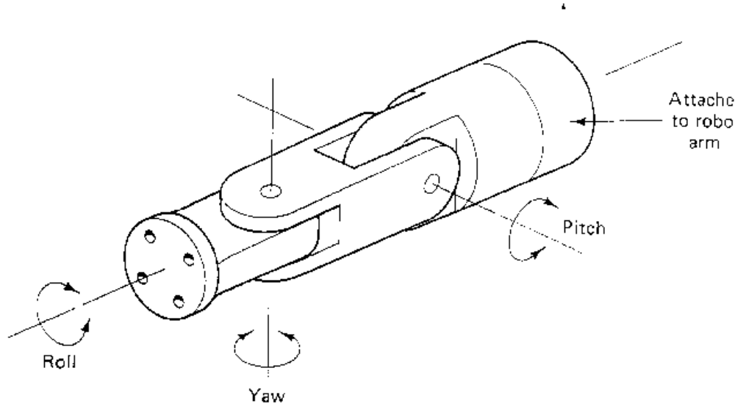
WRIST MOTIONS

Slide 23
CONTROL METHODS
Non Servo Control
  implemented by setting limits or mechanical stops for each joint and sequencing the actuation of each joint to accomplish the cycle
  end point robot, limited sequence robot, bang-bang robot
  No control over the motion at the intermediate points, only end points are known

Slide 24
Programming accomplished by
  setting desired sequence of moves
  adjusting end stops for each axis accordingly
  the sequence of moves is controlled by a “squencer”, which uses feedback received from the end stops to index to next step in the program
Low cost and easy to maintain, reliable
relatively high speed
repeatability of up to 0.01 inch
limited flexibility
typically hydraulic, pneumatic drives

Slide 25
Servo Control
  Point to point Control
  Continuous Path Control
Closed Loop control used to monitor position, velocity (other variables) of each joint

Slide 26
Point-to-Point Control
Only the end points are programmed, the path used to connect the end points are computed by the controller
user can control velocity, and may permit linear or piece wise linear motion
Feedback control is used during motion to ascertain that individual joints have achieved desired location

Slide 27
Often used hydraulic drives, recent trend towards servomotors
loads up to 500lb and large reach
Applications
  pick and place type operations
  palletizing
  machine loading

Slide 28
Continuous Path Controlled
in addition to the control over the endpoints, the path taken by the end effector can be controlled
Path is controlled by manipulating the joints throughout the entire motion, via closed loop control
Applications:
  spray painting, polishing, grinding, arc welding

Slide 29
ROBOT PROGRAMMING
Typically performed using one of the following
  On line
    teach pendant
    lead through programming
  Off line
    robot programming languages
    task level programming

Slide 30
Use of Teach Pendant
hand held device with switches used to control the robot motions
End points are recorded in controller memory
sequentially played back to execute robot actions
trajectory determined by robot controller
suited for point to point control applications

Slide 31
Easy to use, no special programming skills required
Useful when programming robots for wide range of repetitive tasks for long production runs
RAPID

Slide 32
Lead Through Programming
lead the robot physically through the required sequence of motions
trajectory and endpoints are recorded, using a sampling routine which records points at 60-80 times a second
when played back results in a smooth continuous motion
large memory requirements

Slide 33
Programming Languages
Motivation
  need to interface robot control system to external sensors, to provide “real time” changes based on sensory equipment
  computing based on geometry of environment
  ability to interface with CAD/CAM systems
  meaningful task descriptions
  off-line programming capability

Slide 34
Large number of robot languages available
  AML, VAL, AL, RAIL, RobotStudio, etc. (200+)
Each robot manufacturer has their own robot programming language
No standards exist
Portability of programs virtually non-existent

Slide 35
Assignment
As a group, discuss an activity that you think could be automated by using a robot.
Define the tasks that the robot will perform.
What kind of special tooling is required? Sketch if you will use any.
Can the activity be justified economically? Show your development – do not simply say yes or no.

